Slide 1


Slide 2



Insurance Customer Response Prediction
The Insurance Customer Response Prediction project uses machine learning to predict whether a customer will respond positively or negatively to an insurance policy offer. By analysing customer demographics, vehicle characteristics, and insurance history, the project compares multiple classification algorithms to identify an effective predictive model. The goal is to improve customer targeting, optimize marketing strategies, and increase the efficiency of insurance policy sales.
Presented By :- Abhisek Samal

Slide 3

1
5
Introduction: Predict customer responses to insurance policy offers.
Feature Extraction: Separate input features (X) from the target variable (Y) for model training.
2
6
Data Gathering: Data provided by the Boston institute of analytics.(LMS)
Models: Building different Machine learning models and tuning hyperparameters.
3
7
Exploratory Data Analysis: Find patterns and identify trends. Gain valuable insights from the dataset.
Evaluation of Models: Assess model performance using accuracy, precision, recall, F1-score, and ROC-AUC.
4
Data Preprocessing: Cleaning, encoding, scaling, and balancing data for model training.

Slide 4
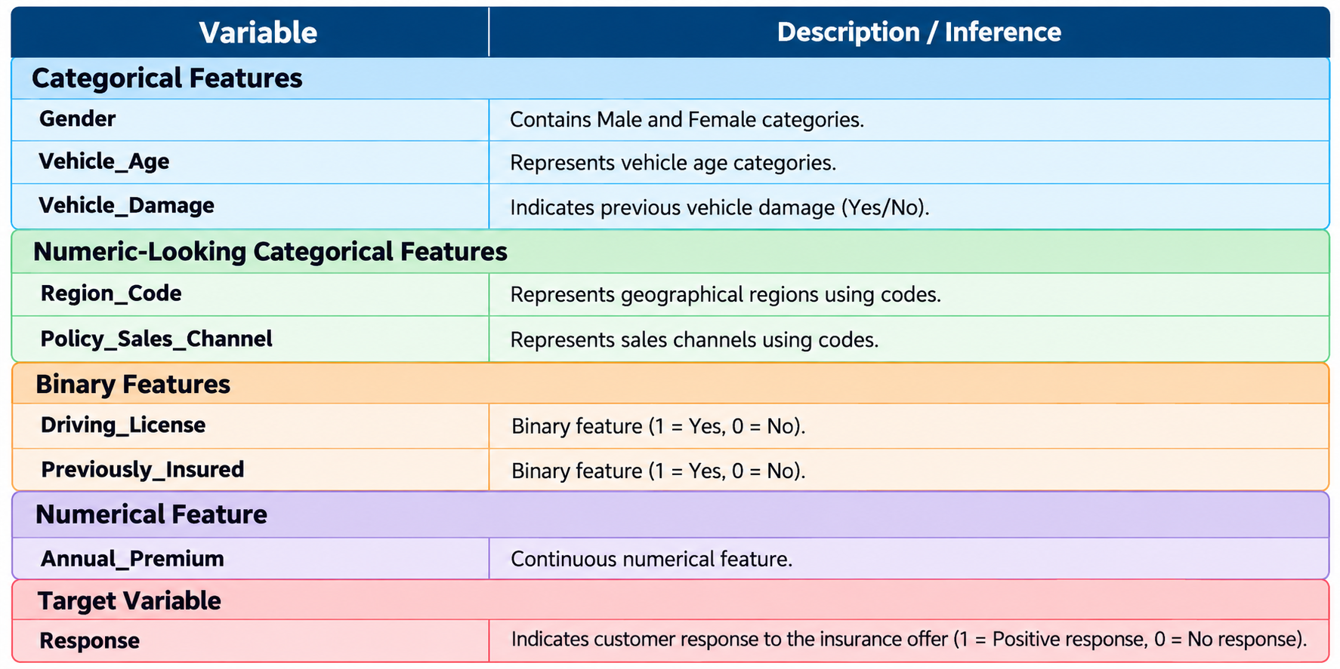
Introduction
The insurance industry increasingly relies on data-driven approaches to understand customer behaviour, improve marketing strategies, and enhance policy sales. One of the major challenges faced by insurance companies is identifying customers who are more likely to respond positively to insurance policy offers. Ineffective customer targeting can lead to unnecessary marketing expenditure, inefficient resource allocation, and lower conversion rates.
1.1 Business Problem
Insurance companies often contact large numbers of customers to promote policy offers, but not all customers respond positively. Identifying potential responders in advance is challenging when marketing strategies do not adequately consider customer characteristics and historical patterns.
Identify customers who are more likely to respond positively.
Improve the effectiveness of targeted marketing campaigns.
Reduce marketing resources spent on unlikely responders.
Support more efficient allocation of sales and marketing resources.
Evaluate model performance using precision, recall, F1-score, accuracy, and ROC-AUC.

Slide 5
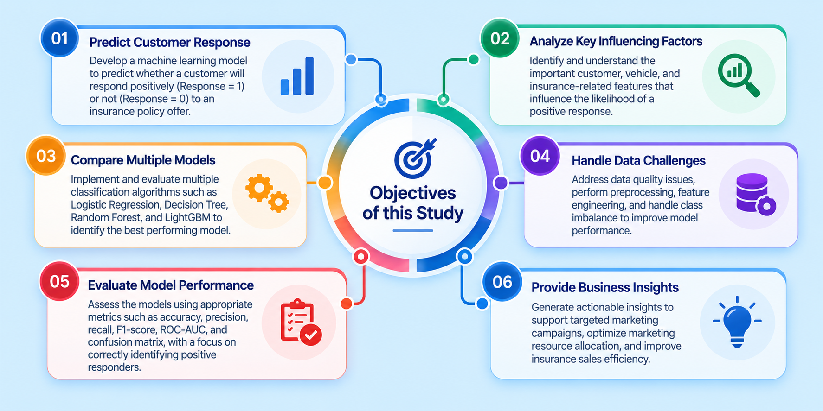
Objectives Of The Study

Slide 6

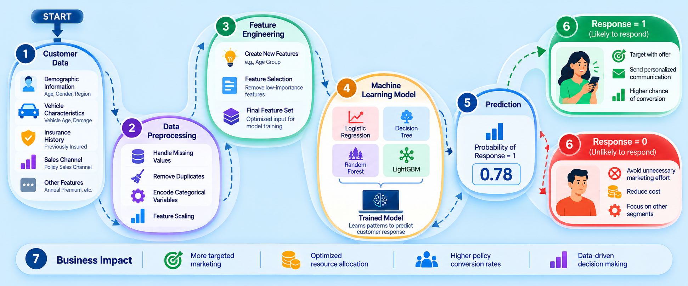
Conceptual Workflow

Slide 7

Exploratory Data Analysis
Exploratory Data Analysis (EDA)
Examined the dataset structure, dimensions, and data types.
Checked for missing values, duplicate records, and data quality issues.
Analysed the distribution of the target variable (Response).
Performed univariate analysis to understand individual feature distributions.
Performed bivariate analysis to explore relationships between features and customer responses.
Studied customer characteristics such as age, gender, vehicle age, vehicle damage, and previous insurance status.
Importance of EDA
Helps understand the dataset before applying machine learning algorithms.
Identifies data quality issues and potential outliers.
Reveals patterns and relationships between customer attributes and insurance responses.
Detects class imbalance in the target variable.
Supports informed decisions about data preprocessing and feature engineering.
Helps identify potentially important features for predicting customer responses.
Provides a foundation for selecting, training, and evaluating suitable classification models
.
PPT takeaway: EDA helps transform raw customer data into meaningful insights and guides the development of a reliable customer response prediction model.
Note: I chose Plotly for EDA because it provides interactive, visually appealing graphs with hover details, zooming, and easy exploration of data patterns compared to Seaborn and Matplotlib. I also use Seaborn and Matplotlib for few Charts.

Slide 8
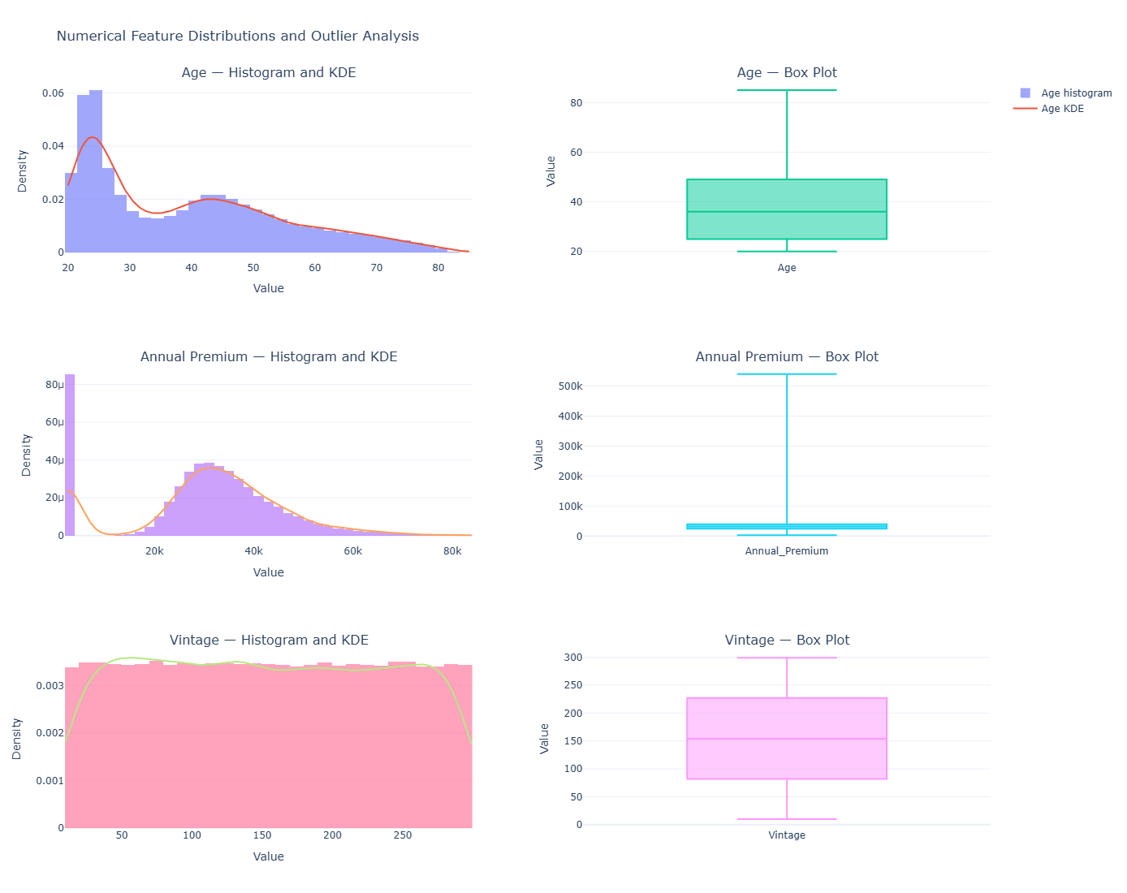
Inferences from Numerical Feature Distributions
Age
Mean: 38.82 years; Median: 36 years.
The majority are young and middle-aged adults.
Represents a broad adult age group.
2. Annual Premium
Strongly right-skewed distribution.
Most values lie between ₹20,000–₹40,000.
Maximum: ₹5,40,165; Median: ₹31,669.
Investigate extreme values before outlier treatment.
3. Vintage
Approximately uniform distribution.
Mean: 154.35 days; Median: 154 days.
Range: 10–299 days.
No obvious extreme outliers.
Overall Recommendations
Retain all three features initially.
Investigate extreme premium values.
Compare preprocessing methods using training data.
Perform bivariate analysis with the target variable, Response.

Slide 9
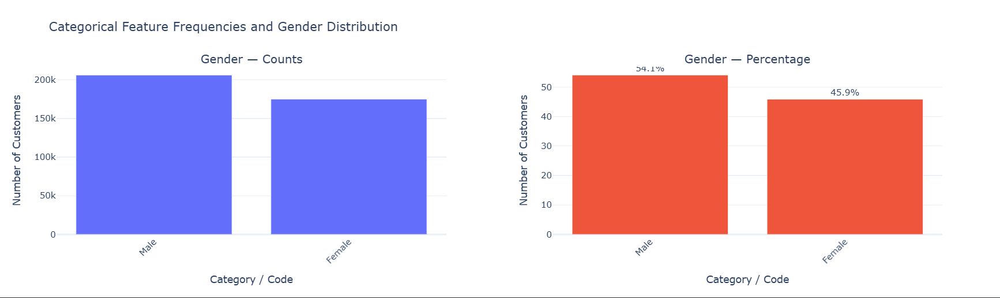
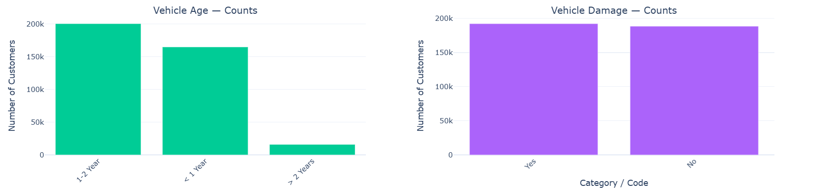
Inferences from Categorical Feature Distributions
1. Gender Distribution
Male: 54.1%; Female: 45.9%.
Relatively balanced distribution.
Analyse gender association with customer response.
2. Vehicle Age Distribution
Vehicles aged 1–2 years form the largest category.
Vehicles under 1 year are the second-largest group.
Vehicles over 2 years are less represented.
Vehicle age may influence customer response.
3. Vehicle Damage Distribution
Damaged and non-damaged vehicles have similar representation.
No major imbalance between categories.
Compare response patterns across both groups.

Slide 10
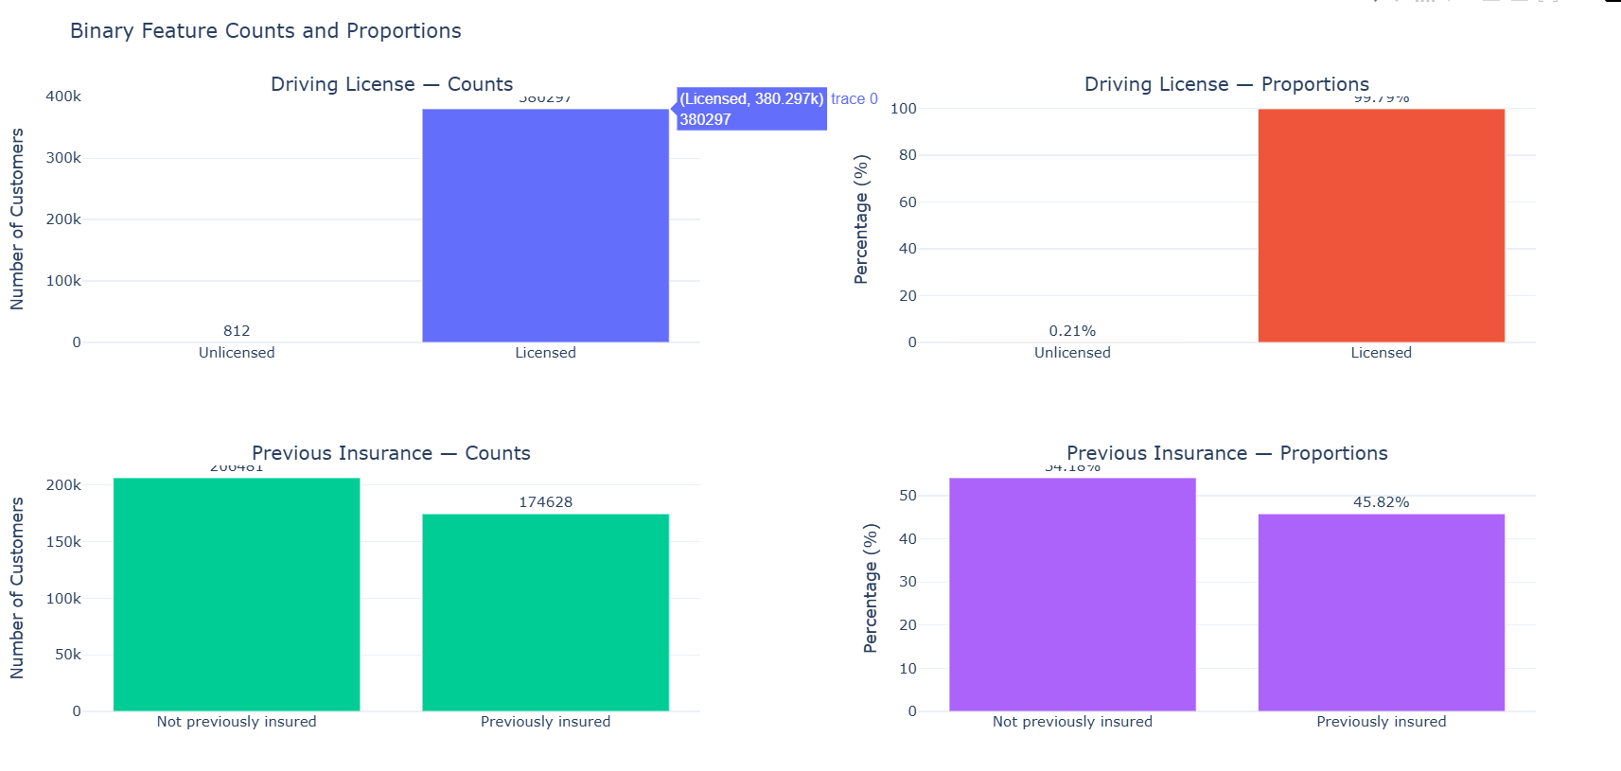
Inferences from Binary Feature Distributions
1. Driving License
99.79% hold a driving license; 0.21% do not.
Highly imbalanced feature distribution.
Predictive importance should be evaluated.
2. Previous Insurance Status
54.18% were not previously insured.
45.82% were previously insured.
- Relatively balanced distribution.
- Suitable for comparing customer response
patterns.

Slide 11
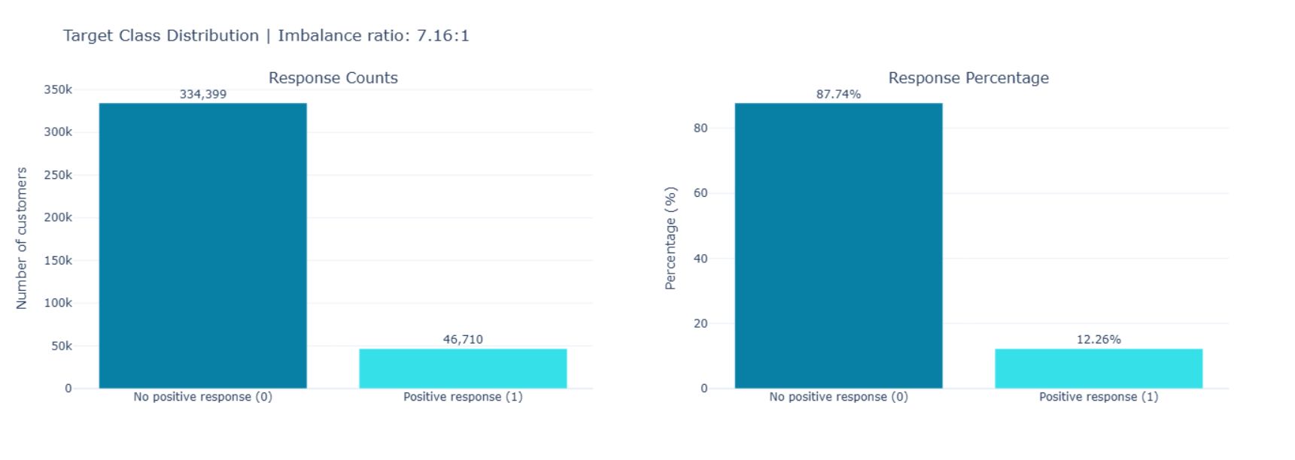
Inferences from Target Variable Distribution
1. Class Distribution
Total records: 381,109.
Negative responses: 87.74% (334,399).
Positive responses: 12.26% (46,710).
2. Class Imbalance
Approximately 7.16 negative responses per positive response.
Predicting only negatives gives 87.74% accuracy.
Accuracy alone is insufficient for evaluation.
Overall Inference
Significant class imbalance exists.
Use appropriate balancing techniques.
Prioritize Precision, Recall, F1-Score, and ROC-AUC to evaluate model performance.

Slide 12
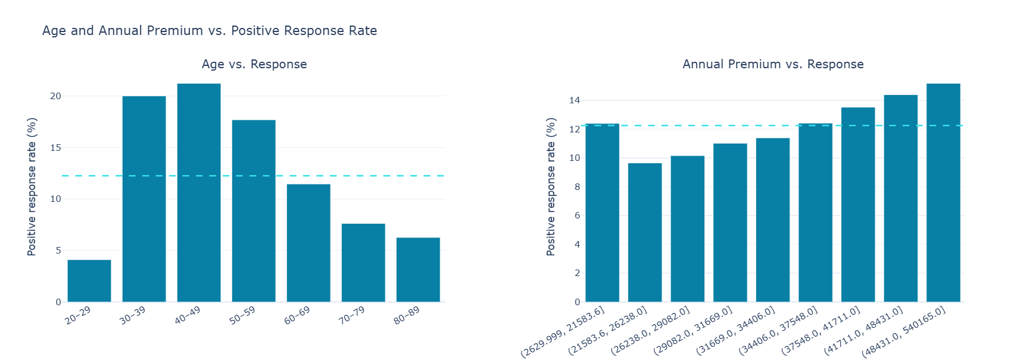
Inferences from Numerical Features vs. Customer Response
1. Age vs. Response
Highest response: 40–49 years (~21%).
Ages 30–39 also show a high response (~20%).
Response declines after 60 years.
Ages 20–29 show the lowest response (~4%).
Inference: Middle-aged customers are more likely to respond positively.
Recommendation: Retain Age and explore nonlinear relationships.
2. Annual Premium vs. Response
Response rates vary across premium intervals.
Lowest response occurs around ₹21,584–₹26,230.
Higher premium groups show response rates of up to ~15%.
The relationship is not strictly linear.
Inference: Annual premium may influence response patterns.
Recommendation: Retain Annual_Premium, investigate extreme values, and test alternative binning methods.

Slide 13
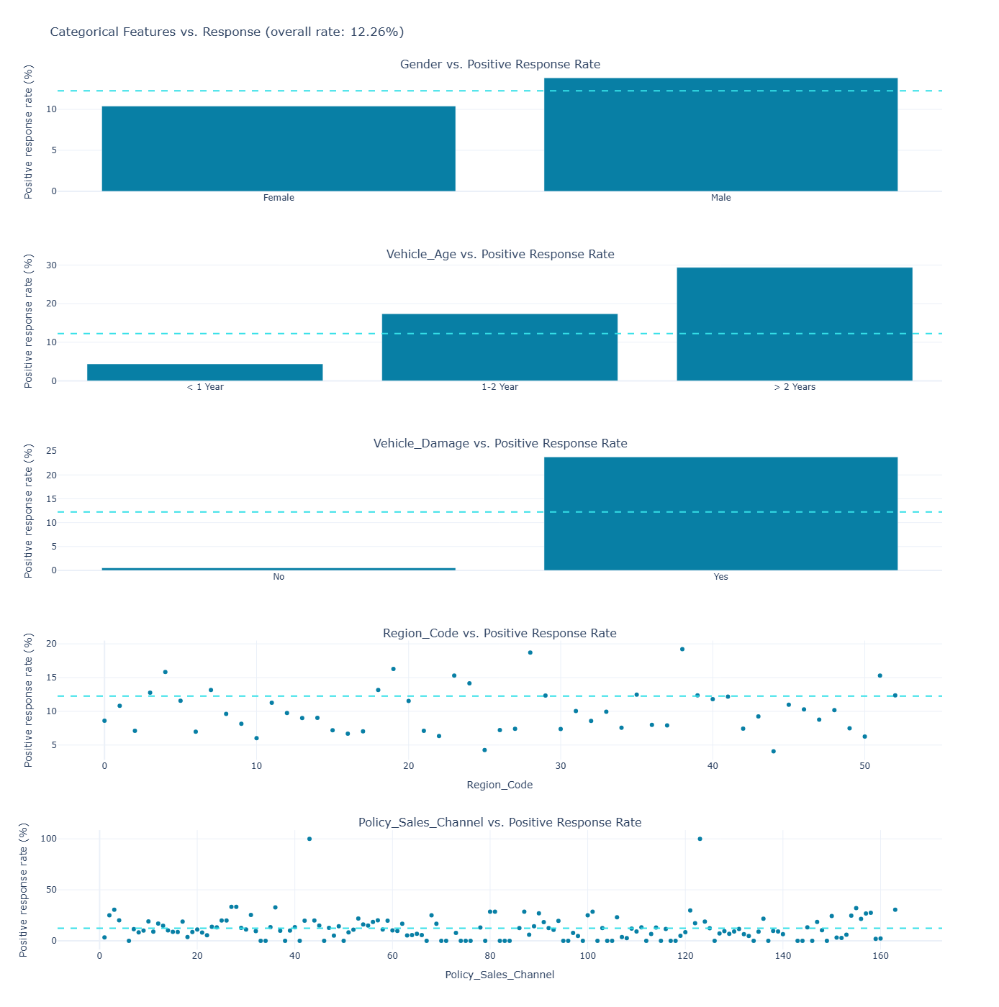
Inferences from Categorical Features vs. Customer Response
Overall Positive Response Rate: 12.26%
The dashed cyan line represents the overall positive response rate.
1. Gender vs. Response
Male: Positive response rate of approximately 13–14%.
Female: Positive response rate of approximately 10%.
Inference: Male customers respond more positively than female customers. Gender may be associated with customer response, although the difference is moderate.
2. Vehicle Age vs. Response
Above 2 years: Highest positive response rate at approximately 29%.
1–2 years: Positive response rate of approximately 17%.
Below 1 year: Lowest positive response rate at approximately 4%.
Inference: Positive response rates increase substantially with vehicle age. Vehicle age appears to be a potentially informative predictor of customer response.
3. Vehicle Damage vs. Response
Previously damaged vehicles: Positive response rate of approximately 24%.
No previous damage: Positive response rate of approximately 0.5%.
Inference: Previous vehicle damage shows a pronounced association with customer response and may be an important predictor.
4. Region Code vs. Response
Positive response rates vary across geographical region codes.
Some regions show response rates above the 12.26% overall average, while others have noticeably lower rates.

Slide 14
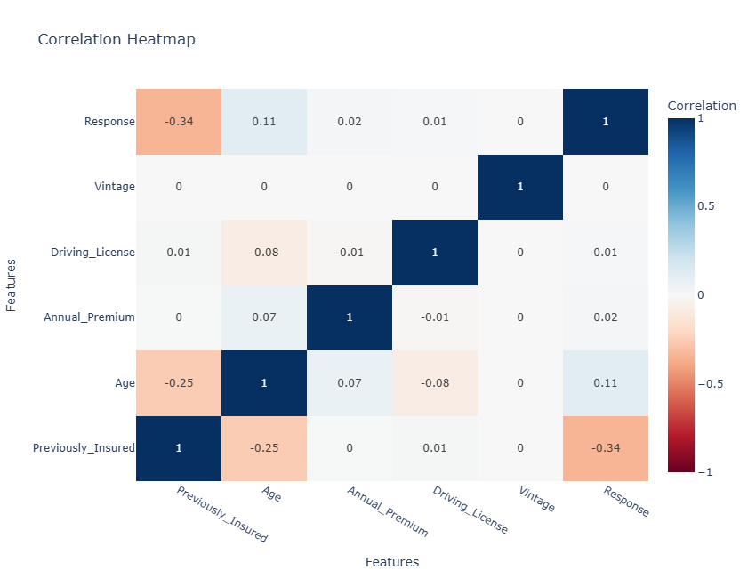
Inference from Correlation Heatmap
Vintage (r ≈ 0.00): Shows virtually no linear correlation with customer response and is unlikely to contribute much predictive information on its own.
Driving License (r ≈ 0.01): Has a negligible correlation with customer response, indicating very limited standalone predictive value.
Annual Premium (r ≈ 0.02): Shows an extremely weak positive correlation with customer response and may have limited predictive importance.
Overall Inference: Vintage, Driving License, and Annual Premium exhibit near-zero linear correlations with the target variable. However, correlation alone cannot determine their actual contribution to model performance; their predictive value should be confirmed through feature importance or ablation testing.

Slide 15

Data Preprocessing
Feature Selection: Removed irrelevant or excluded columns such as id, Vintage, Driving_License, and Annual_Premium.
Feature Engineering: Created an Age_Group feature from the Age column to categorize customers into age groups.
Categorical Encoding: Converted categorical variables into numerical representations using binary encoding and one-hot encoding.
Feature Scaling: Applied StandardScaler to standardize numerical features for machine learning.
Handling Class Imbalance: Used SMOTE (Synthetic Minority Over-sampling Technique) to generate synthetic samples of the minority class.
Train-Test Split: Divided the dataset into training and testing sets using stratified sampling to preserve the target class distribution.
No missing, duplicate, or null values were found. Note: Apply SMOTE only to the training data after splitting to prevent data leakage and obtain reliable evaluation results.
Train Test Split
- I divided the data into training (80%) and testing(20%) sets.
-Setting a random_state ensures reproducibility of the results. The dataset was divided into two parts: X, representing the independent variables (features), and y, representing the dependent variable (target) that the model aims to predict.

Slide 16

Machine Learning Models
Logistic Regression
Used as a baseline classification model to predict customer responses to insurance policy offers.
Estimates the probability of a customer responding positively (Response = 1) or negatively (Response = 0).
Simple, computationally efficient, and relatively easy to interpret.
Helps understand the relationship between input features and the target variable.
Benefits from feature scaling, particularly when regularization is applied, and may struggle to capture complex nonlinear relationships.
2. Decision Tree Classifier
Uses a tree-like structure of decision rules to classify customer responses.
Captures nonlinear relationships and interactions between features.
Easy to understand and visualize.
Requires minimal preprocessing and does not require feature scaling.
3. Random Forest Classifier
An ensemble learning algorithm that combines multiple decision trees.
Uses bootstrap sampling and random feature selection to improve predictive robustness.
Often reduces overfitting compared with a single decision tree.
Captures complex nonlinear patterns in customer behaviour.
Requires more computational resources and is less interpretable than an individual decision tree.
4. LightGBM Classifier
A gradient boosting algorithm that builds decision trees sequentially, with each new tree improving upon the existing model.
Uses leaf-wise tree growth to improve learning efficiency and predictive performance.
Handles large datasets and complex feature interactions efficiently.
Supports class weighting and other techniques to address class imbalance
Overall Objective
Develop and compare four classification models to predict customer responses to insurance policy offers.
Evaluate model performance using precision, recall, F1-score, ROC-AUC, and the confusion matrix.

Slide 17
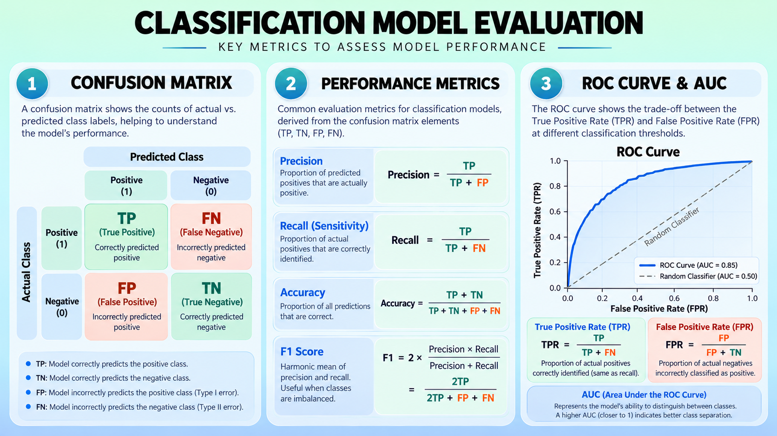

Slide 18
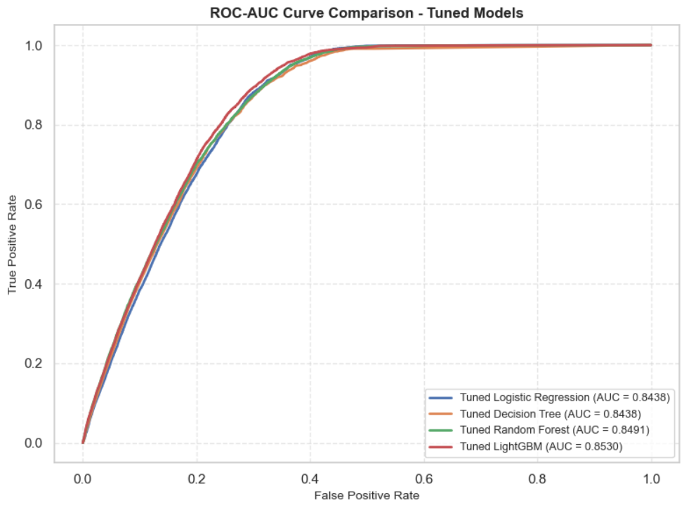
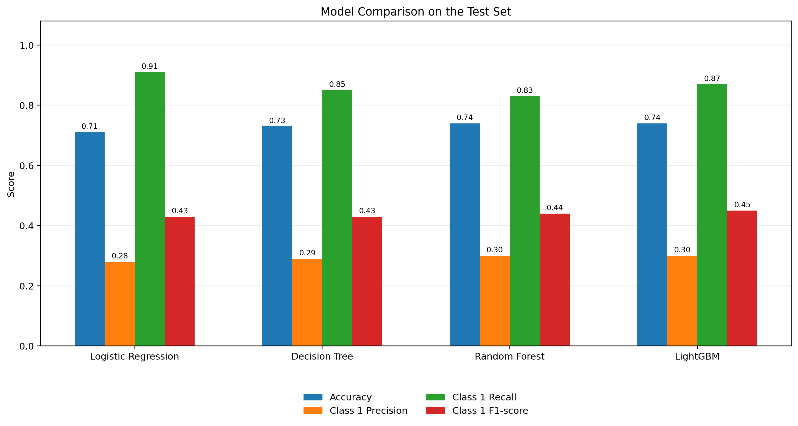
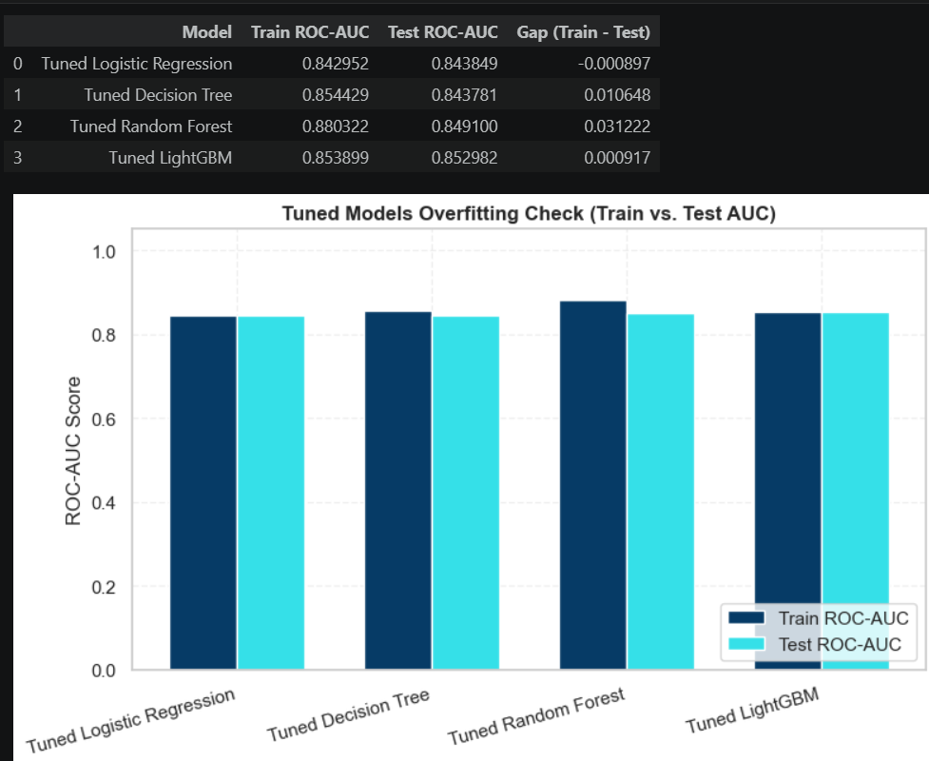
Model Evaluation:
ROC (Receiver Operating Characteristic) curve: Shows the trade-off between the True Positive Rate (Recall) and the False Positive Rate at different classification thresholds.
AOC (Area Under the Curve): Summarizes the model's ability to distinguish between the two classes.

Slide 19


Experimental Approach
Initial Modelling: Trained the model using all available features, resulting in poor performance.
Feature Selection: Removed low-correlation features to reduce noise and improve model performance.
Threshold Tuning: Adjusted the classification threshold to improve selected evaluation metrics, particularly classification performance.
Final Observation: Despite some improvement in scores, the model exhibited signs of overfitting, indicating limited generalization.
Further Improvement: The experiment highlighted the need for better feature selection, hyperparameter optimization, and cross-validation to achieve a more robust and reliable model.
Project Guidelines:
Data Exploration: Conduct comprehensive EDA using visualization techniques to understand feature distributions and relationships with customer responses. ( For better visualization, I also used Plotly)
Data Preprocessing: Handle any missing values, encode categorical variables, and apply appropriate scaling techniques.
Feature Engineering: Consider creating new features (e.g., combining age and driving license information) and analyze feature importance.
Model Selection: Evaluate various classification algorithms, including Logistic Regression, Decision Tree Classifier, and Random Forest Classifier. ( I also built Lightgbm model)
Performance Evaluation: Use appropriate metrics such as Accuracy, Precision, Recall, F1-Score, and ROC-AUC to assess model performance.
Visualization: Create clear and informative visualizations using libraries like Matplotlib and Seaborn to communicate data insights and model performance. ( For better visualization, I also used Plotly)

Slide 20

Conclusion
1. Key Findings
Four machine learning models—Logistic Regression, Decision Tree, Random Forest, and LightGBM—were developed and evaluated for insurance customer response prediction.
Among the evaluated models, LightGBM achieved the best overall discrimination performance, with a ROC-AUC of 0.8530 and a PR-AUC of 0.3583.
Random Forest also demonstrated competitive performance, achieving a ROC-AUC of 0.8491 and a PR-AUC of 0.3548.
The dataset exhibited significant class imbalance, with approximately 87.74% negative responses and 12.26% positive responses, making minority-class prediction an important challenge.
The analysis highlighted the importance of evaluating precision, recall, F1-score, and ROC-AUC alongside accuracy to understand model performance more comprehensively.
The findings indicate that machine learning can help identify potential insurance customers and support more targeted marketing strategies.
2. Limitations
Class Imbalance: The substantial difference between positive and negative responses may affect the model's ability to identify genuine positive responders.
Limited Generalizability: The analysis was conducted on a single dataset, and the results may not generalize to other insurance companies, regions, or customer populations.
Feature Limitations: The model's predictive capability depends on the available customer attributes, which may not capture all factors influencing insurance purchasing decisions.
Potential Information Loss: Excluding selected features during preprocessing may remove information that could contribute to prediction.
Practical Validation: The models have been evaluated on a test dataset, but their effectiveness in real-world insurance marketing campaigns has not been established.
3. Future Research
Advanced Feature Engineering: Explore additional customer attributes and interactions to improve predictive performance.

Slide 21


